Slide 1
Fourier Transform and its Applications
Teo Feliu

Slide 2
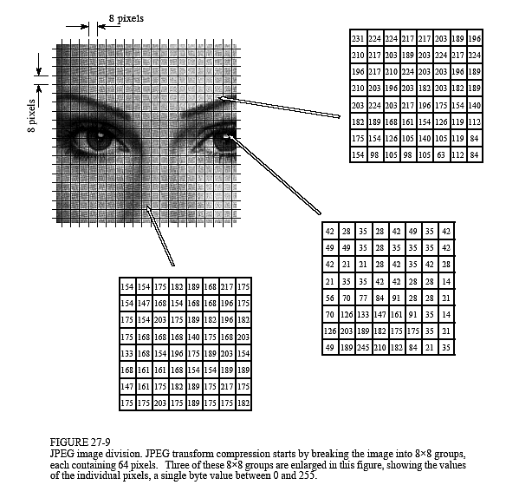
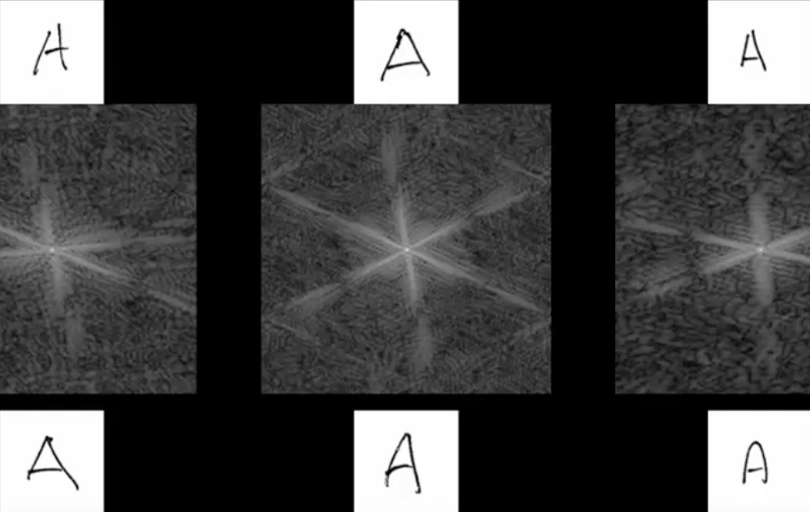
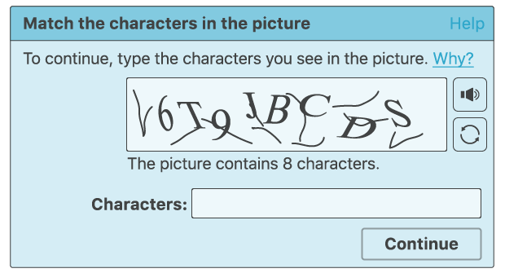
The Problem
Data is everywhere, and while it is easy to store, it is very hard to manipulate, process, and move around
Sending and processing large data sets like streaming video or a Wi-Fi connection can take time and usually need to be performed in real time
Computers are really bad at recognizing images

Slide 3
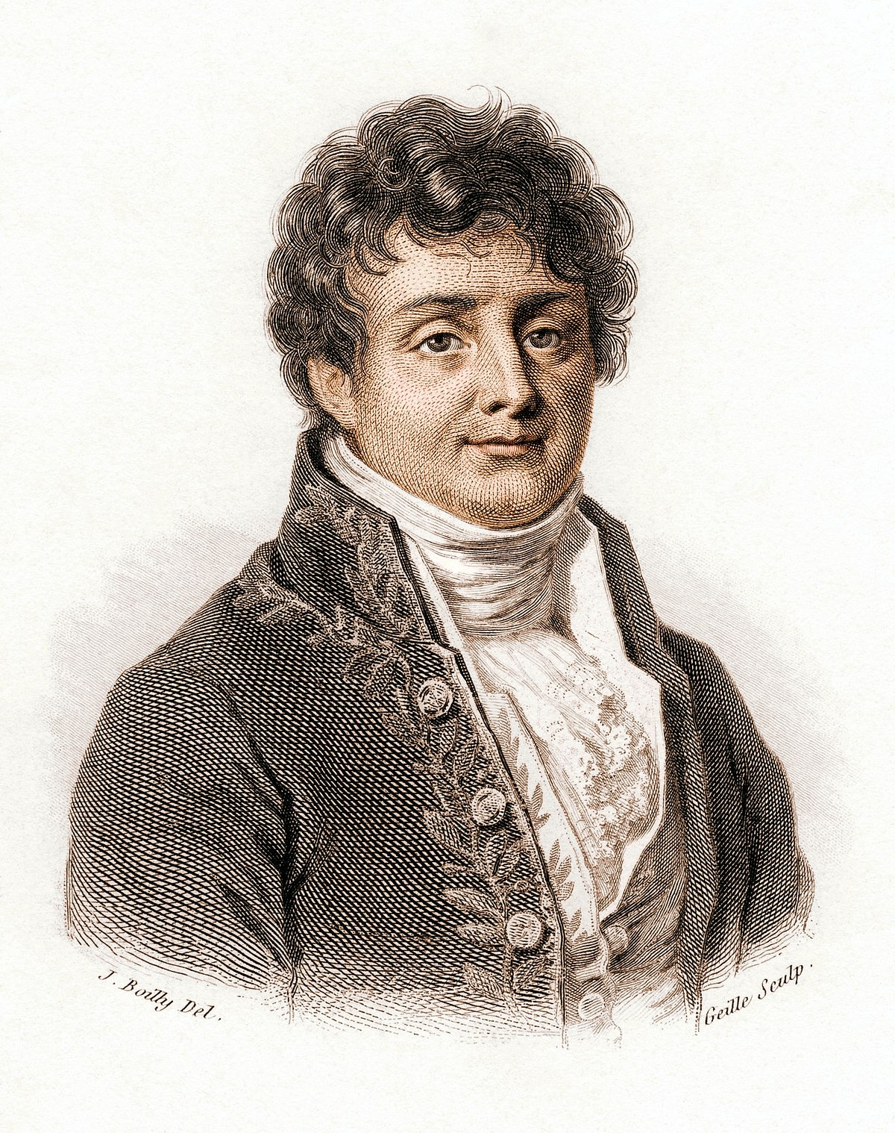
Background
Joseph Fourier

Slide 4
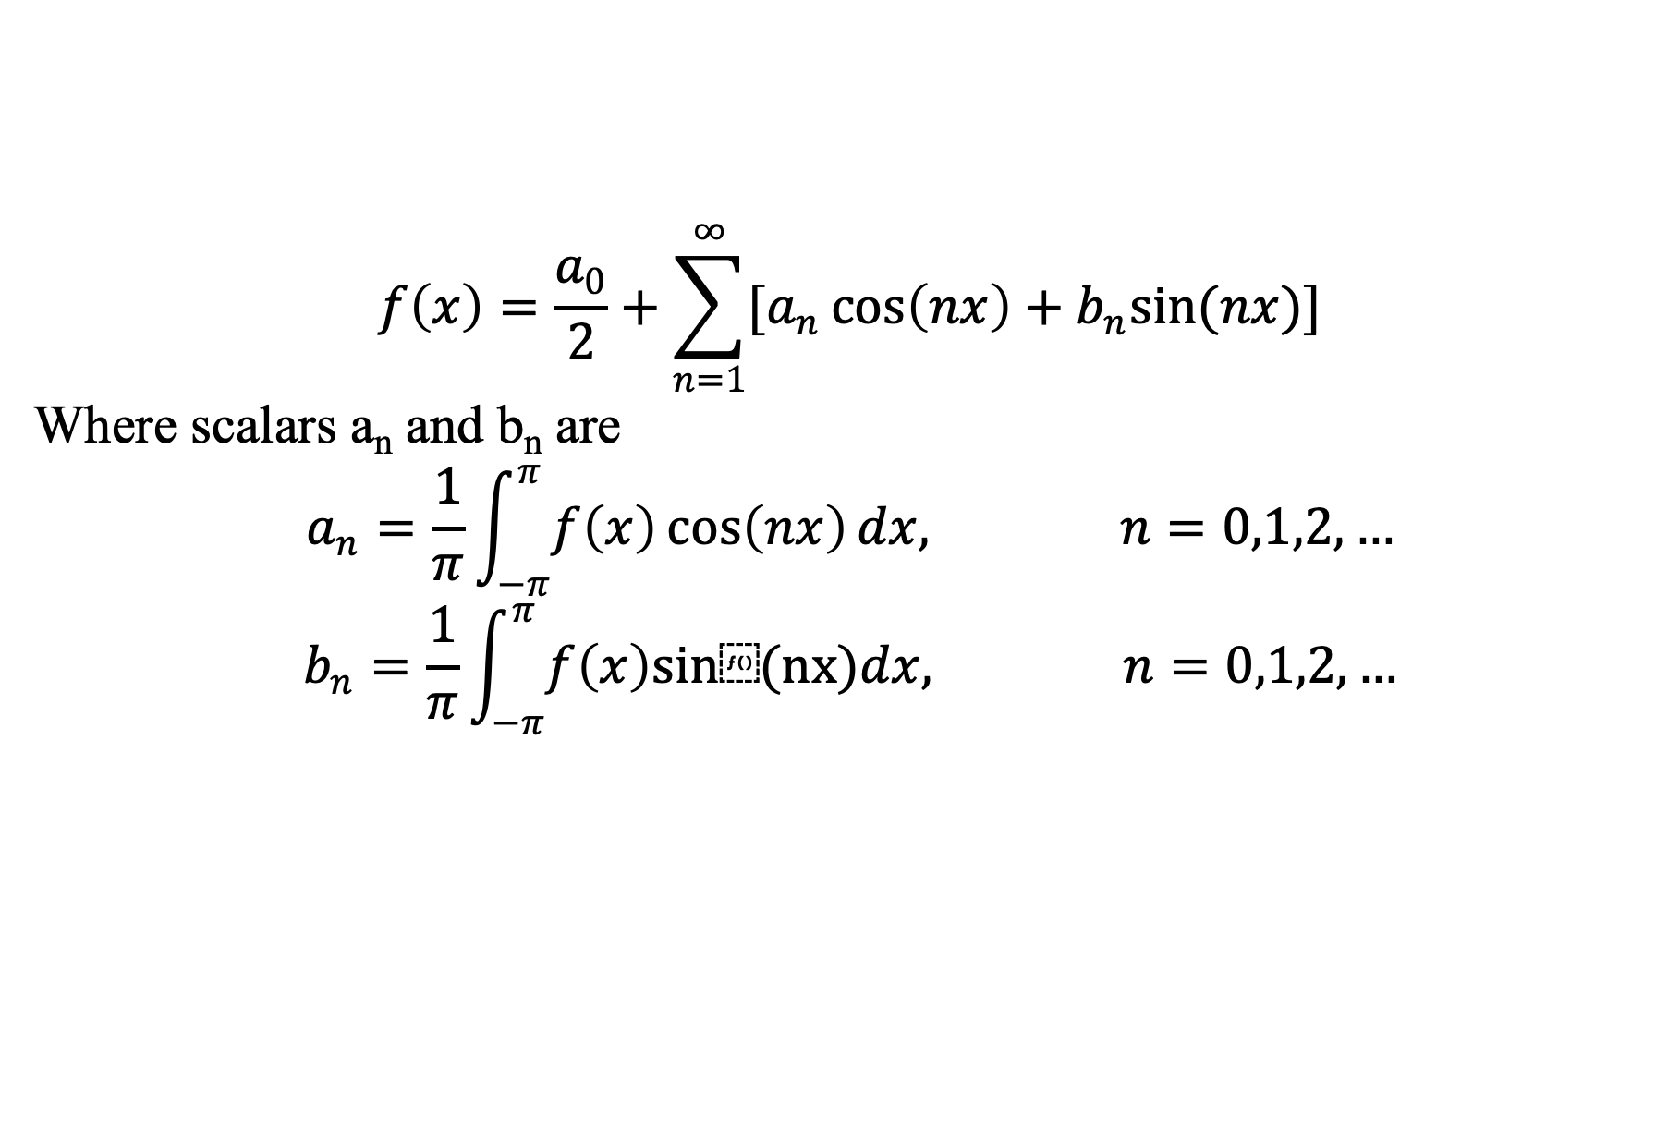
Fourier Series
Represent functions as linear combinations of sinusoids over a period
$$f\left(x\right)=\frac{a_{0}}{2}+\sum_{n=1}^{∞}{[a_{n}\cos\left(nx\right)+b_{n}sin(nx)]}$$
Where scalars a_{n} and b_{n} are
$$a_{n}=\frac{1}{π}\int_{−π}^{π}{f\left(x\right)\cos\left(nx\right)dx, n=0,1,2,…}$$
$$b_{n}=\frac{1}{π}\int_{−π}^{π}{f\left(x\right)sin⁡(nx)dx, n=0,1,2,…}$$

Slide 5
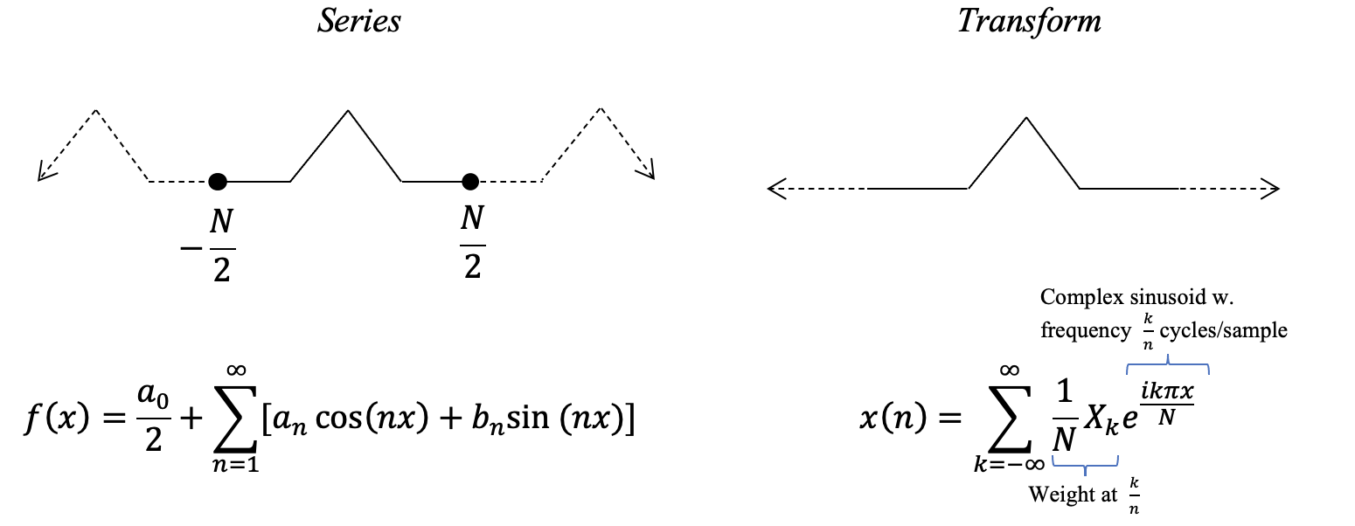
Fourier Series and Fourier Transform

Slide 6
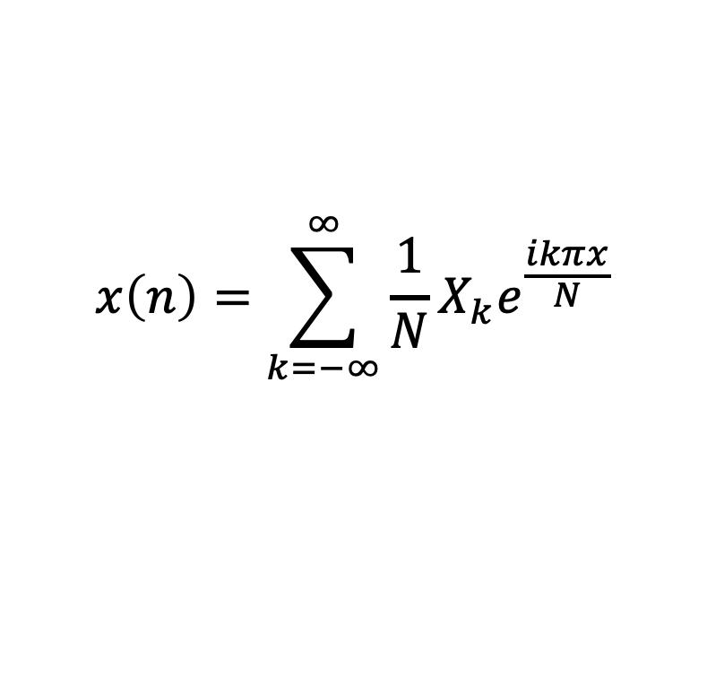
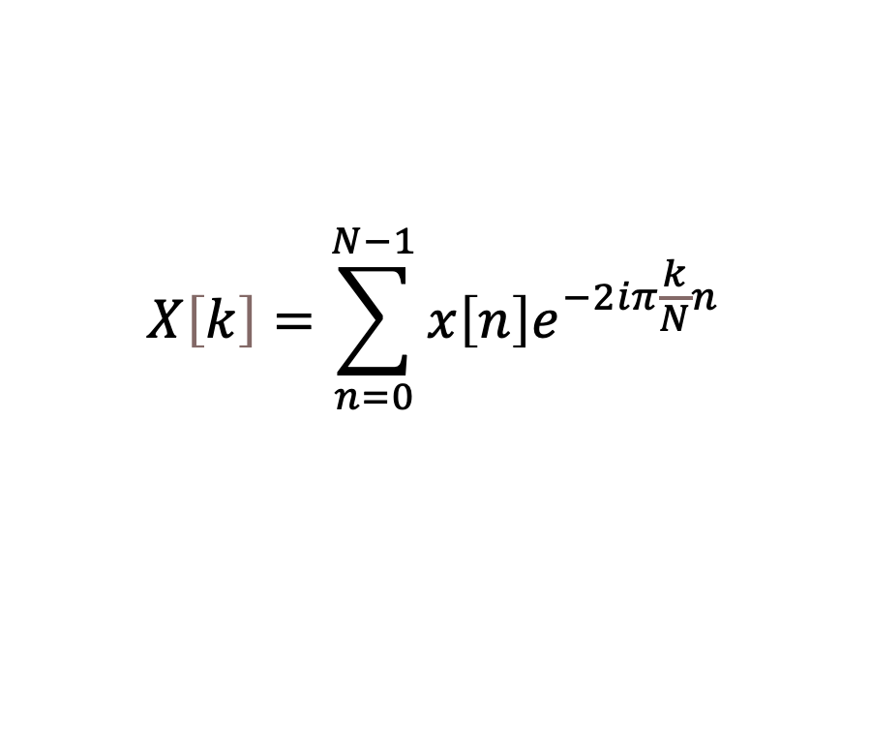
$$x\left(n\right)=\sum_{k=−∞}^{∞}{{\frac{1}{N}X}_{k}e^{\frac{ikπx}{N}}}$$
$$X\left[k\right]=\sum_{n=0}^{N−1}{x\left[n\right]e^{−2iπ\frac{k}{N}n}}$$
x[n]- Discrete time signal
X[k]- frequency spectrum

Slide 7
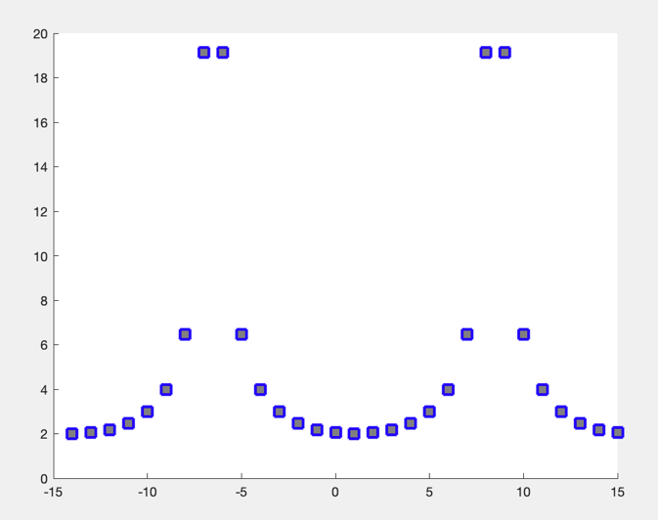
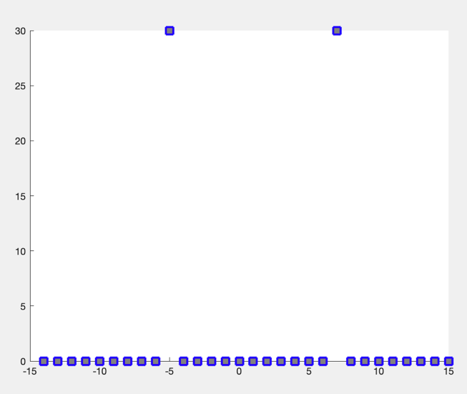
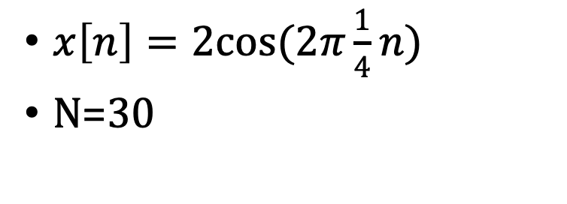
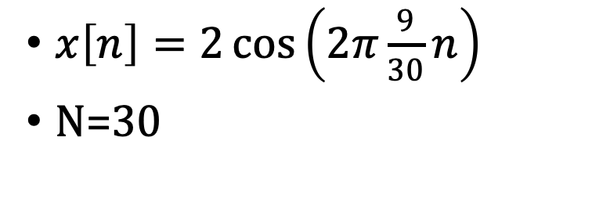
Correlation between Frequencies
$x\left[n\right]=2cos(2π\frac{1}{4}n)$
N=30
$x\left[n\right]=2\cos\left(2π\frac{9}{30}n\right)$
N=30
Notes:
Frequency of discrete time signal x[n] is ¼ or 9/30, frequency of X[k] is 1/30

Slide 8
DFT vs FFT
Discrete Fourier Transform, O(N²)
Fast Fourier Transform, O(NlogN)
%x=@(n) 2*cos(2*pi*(11/40)*n) input as a function
x = [0.5 0.5 0 0 0 0 0 0 0 0] % input as a set of points
%x=rand(1,100)*10 % input as a set of 100 random points
N=length(x)
X = zeros(1,N) % X[g] is the result of the sum for x=g
k=-floor((N-1)/2) % k is used to center the graph
figure;
hold on;
for g=0:N-1
for j=0:N-1
X(g+1)=X(g+1)+x(j+1)*exp(-2i*pi*(g/N)*j)
end
plot(k,abs(X(g+1)),'--gs','LineWidth',2,'MarkerSize',10,'MarkerEdgeColor','b','MarkerFaceColor',[0.5,0.5,0.5])
k=k+1
end
display(X)
x = rand(1,8)*10;
N=length(x);
p=ceil(log2(N));
N = 2^p;
N2=N/2;
WW = exp(-pi*i/N2);
W=WW.^(0 : N2-1);
for j=1:p-1
t=x(:,1:N2)+x(:,N2+1:N);
x=[t ; W.*(x(:,1:N2)-x(:,N2+1:N))];
W=[W(:,1:2:N2); W(:,1:2:N2)];
N=N2;
N2=N2/2;
end;
u=x(:,1);
v=x(:,2);
x=[u+v;u-v];
plot(abs(x),'--gs','LineWidth',2,'MarkerSize',10,'MarkerEdgeColor','b','MarkerFaceColor',[0.5,0.5,0.5])

Slide 9
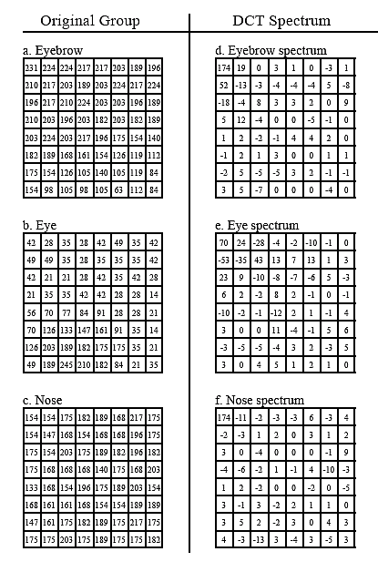
JPEG Compression
When looking at an image in terms of frequencies, the highest frequencies are the least important
Removing 50% from the higher frequencies could only remove, say 5% of the image
Data in terms of frequencies take up less space
This extends to compressing more dense forms of media/data

Slide 10
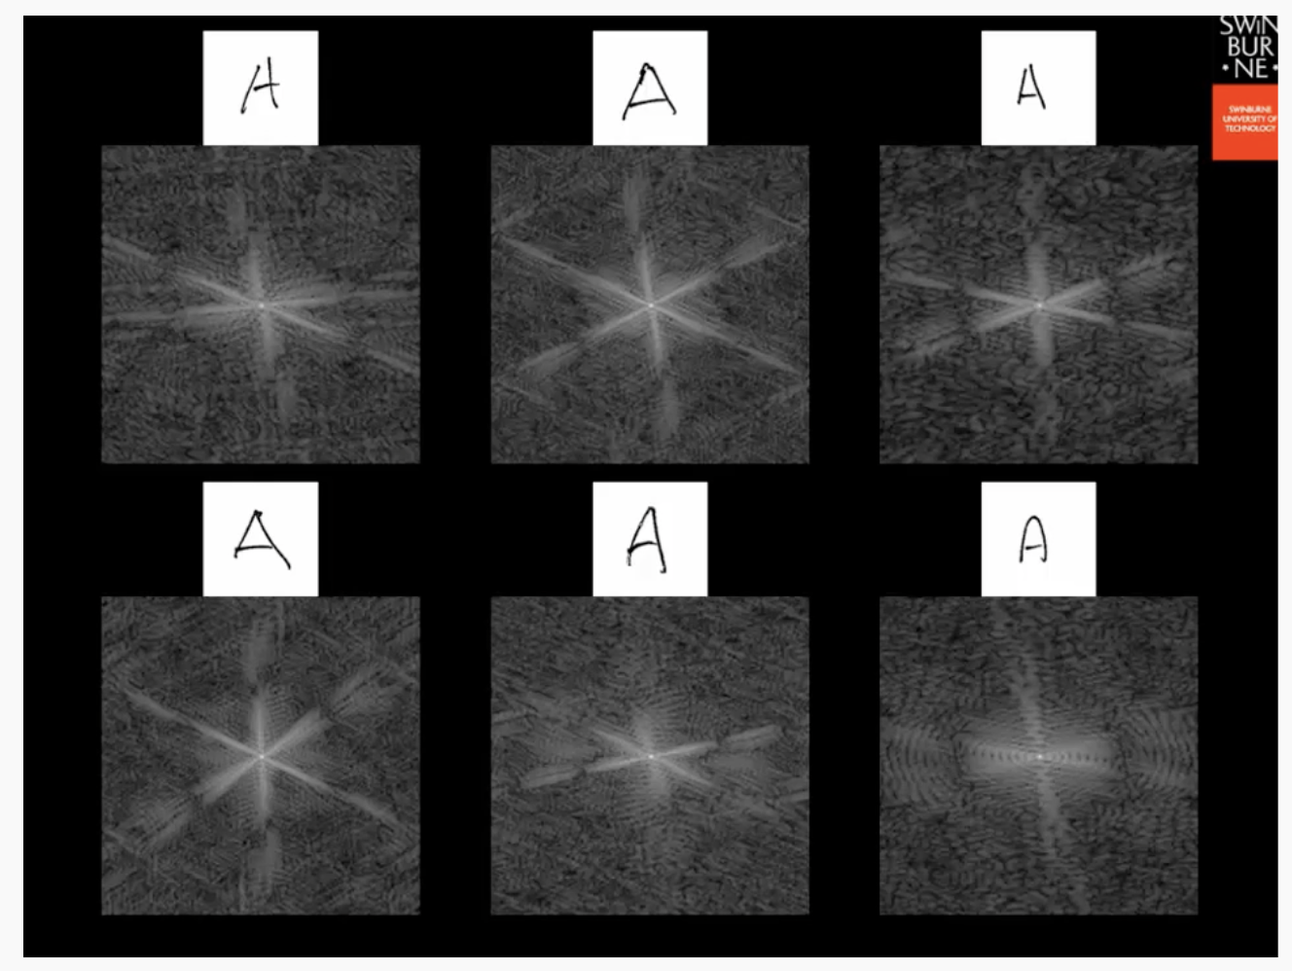
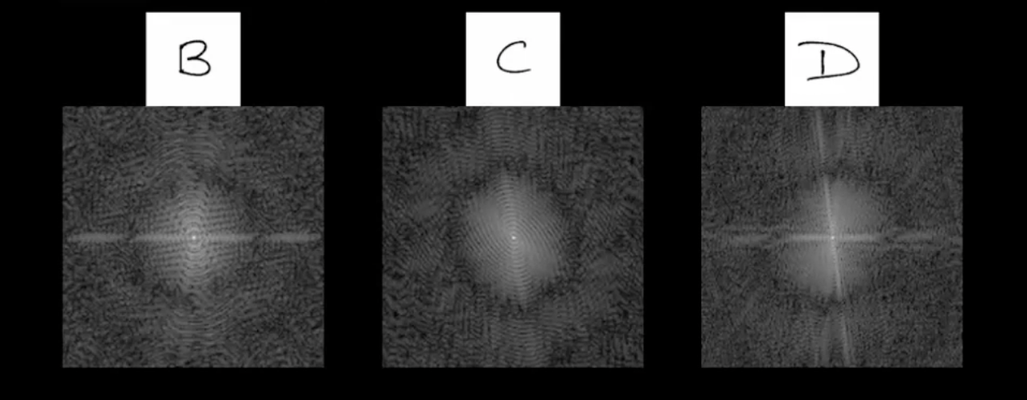
Image Processing
Humans are very good at recognizing and categorizing images, symbols, and patterns
For computers this is very hard, since they look at the data that make up the images
Putting the data in terms of frequency creates patterns that are much more easily recognizable

